Slide 1
Recognising geometric sequences
Non-linear relationships

Slide 2
how to use Oak lessons

Slide 3
I can recognise a geometric sequence.

Slide 4
A geometric sequence is a sequence with a constant multiplicative relationship between successive terms.
A common ratio is a key feature of a geometric sequence. The constant multiplier between successive terms is called the common ratio.

Slide 5

Recognising geometric sequences
Finding the common ratio
Using the common ratio

Slide 6
Finding the common ratio
In a geometric sequence, there is a common multiplicative relationship between each term.
162 ÷ 54 = 3
2, | 6, | 18, | 54, | 162, | …
54 ÷ 18 = 3
×3
×3
×3
×3
×3
×3
×3
×3
18 ÷ 6 = 3
6 ÷ 2 = 3
To check a sequence is geometric we can take each term and divide it by the previous term to check there is a common multiplier.

Slide 7
Finding the common ratio
This common multiplier is called the common ratio.
2, | 6, | 18, | 54, | 162, | …
2 | : | 6
6 | : | 18
18 | : | 54
54 | : | 162
2 | : | 6
1 | : | 3
6 | : | 18
18 | : | 54
54 | : | 162
2 | : | 6
1 | : | 3
6 | : | 18
1 | : | 3
18 | : | 54
1 | : | 3
54 | : | 162
1 | : | 3
2 | : | 6
1 | : | 3
6 | : | 18
1 | : | 3
18 | : | 54
54 | : | 162
2 | : | 6
1 | : | 3
6 | : | 18
1 | : | 3
18 | : | 54
1 | : | 3
54 | : | 162
÷3
÷3
×3
×3
×3
×3
×3
×3
×3
×3
You can see why it is called a common ratio, as each pair of terms is in the same ratio.
÷6
÷6
Cancel each ratio to its simplest form.
÷18
÷18
÷54
÷54

Slide 8


Finding the common ratio
To find the common ratio in a geometric sequence, you should …
multiply consecutive terms together.
subtract the previous term from each term.
divide each term by the previous term.

Slide 9
Finding the common ratio
Find the common ratio in this geometric sequence.
22, | 242, | 2662, | 29 282, | 322 102, | …
×11
×11
×11
×11
322 102 ÷ 29 282 = 11
29 282 ÷ 2662 = 11
2662 ÷ 242 = 11
242 ÷ 22 = 11
By dividing each term by the previous term we find a common ratio of 11

Slide 10



Finding the common ratio
Sofia and Aisha are looking at another sequence.
80, | 200, | 500, | 1250, | 3125, | …
Test it. Take each term and divide it by the previous term. If you find a common multiplicative relationship between each term the sequence is geometric.
This sequence can’t be geometric then because 80 is not a factor of 200 and 200 is not a factor of 500

Slide 11
Finding the common ratio
Sofia and Aisha are looking at another sequence.
80, | 200, | 500, | 1250, | 3125, | …
Test it. Take each term and divide it by the previous term. If you find a common multiplicative relationship between each term the sequence is geometric.
×2.5
×2.5
×2.5
×2.5
200 ÷ 80 = 2.5
500 ÷ 200 = 2.5
1250 ÷ 500 = 2.5
3125 ÷ 1250 = 2.5
This sequence is geometric! It has a decimal common ratio.

Slide 12


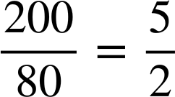
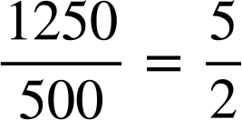
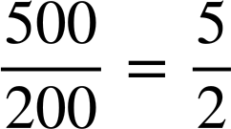
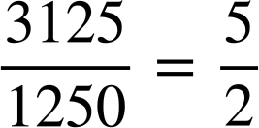
Finding the common ratio
Sofia and Aisha are looking at another sequence.
80, | 200, | 500, | 1250, | 3125, | …
It’s better to think of it as a fractional multiplier. 2.5 =
200 ÷ 80 = 2.5
500 ÷ 200 = 2.5
1250 ÷ 500 = 2.5
3125 ÷ 1250 = 2.5
This sequence is geometric! It has a decimal common ratio.

Slide 13

Finding the common ratio
Lucas is trying to find the 5th term in this geometric sequence.
162, | 216, | 288, | 384, | ? , | …
What advice do you think Aisha is going to give Lucas and why?
216 ÷ 162 = 1.33 (to 2 d.p.)
288 ÷ 216 = 1.33 (to 2 d.p.)
384 ÷ 288 = 1.33 (to 2 d.p.)
The common ratio is 1.33 so the next term is 384 × 1.33 = 510.72

Slide 14

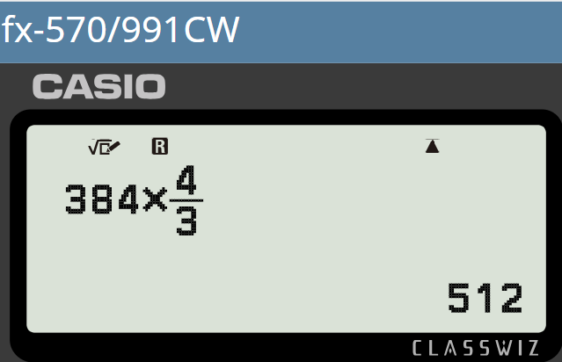
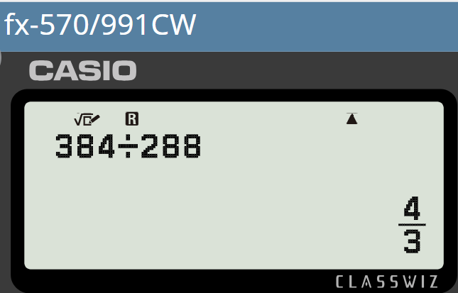
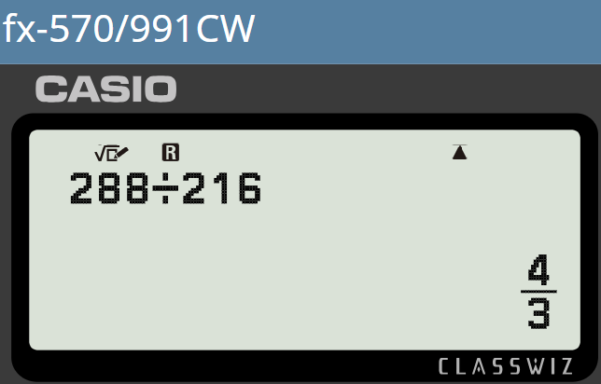
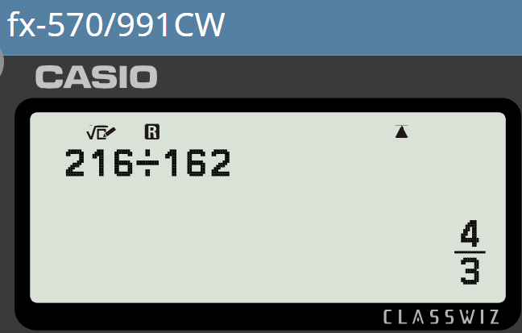
Finding the common ratio
Lucas is trying to find the 5th term in this geometric sequence.
162, | 216, | 288, | 384, | ? , | …
162, | 216, | 288, | 384, | 512, | …
Leave your common ratio in fraction form for accuracy and efficiency. Your calculator will help you do this.
216 ÷ 162 = 1.33 (to 2 d.p.)
288 ÷ 216 = 1.33 (to 2 d.p.)
384 ÷ 288 = 1.33 (to 2 d.p.)
The common ratio is 1.33 so the next term is 384 × 1.33 = 510.72

Slide 15
Finding the common ratio
Lucas is trying to find the 5th term in this geometric sequence.
162, | 216, | 288, | 384, | 512, | …
Leave your common ratio in fraction form for accuracy and efficiency. Your calculator will help you do this.
Thanks Aisha!

Slide 16
Finding the common ratio
Lucas and Aisha find this sequence.
5, | 10, | 30, | 120, | 600, | …
Remember, it has to be a common multiplicative relationship between each term in order for the sequence to be geometric.
The multiplier changes in your sequence so it is not geometric.
×2
×3
×4
×5
I’m enjoying geometric sequences. This one has a really strange pattern!
A geometric sequence must have a constant multiplicative relationship between terms.

Slide 17
Finding the common ratio
Which of these are geometric sequences?
71, | 213, | 639, | 1917, | 5751, | …
Constant multiplicative relationship - Geometric
×3
×3
×3
×3
71, | 142, | 426, | 852, | 2556, | …
Not a constant multiplier - Not geometric
×2
×3
×2
×3
71, | 142, | 568, | 4544, | 72 704, | …
Not a constant multiplier - Not geometric
×2
×4
×8
×16
71, | 355, | 1775, | 8875, | 44 375, | …
Constant multiplicative relationship - Geometric
×5
×5
×5
×5

Slide 18
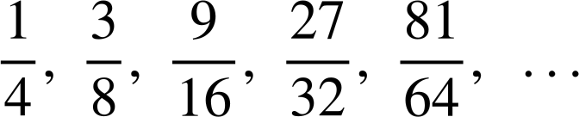
Finding the common ratio
1) Divide each term by the previous term to find the common ratio in each of these geometric sequences.
a) | 15, | 105, | 735, | 5145, | 36 015, | …
b) | 0.08, | 0.72, | 6.48, | 58.32, | 524.88, | …
c) | 567, | 189, | 63, | 21, | 7, | …
d)

Slide 19
Finding the common ratio
2) a) This sequence is geometric. Show that it is and write a sentence to justify why it is.
768, 576, 432, 324, 243, …
b) This sequence is not geometric. Show that it is not and write a sentence to justify why it is not.
756, 252, 126, 42, 21, …

Slide 20
Finding the common ratio
1) Divide each term by the previous term to find the common ratio in each of these geometric sequences.
a) | 15, | 105, | 735, | 5145, | 36 015, | …
36 015 ÷ 5145 = 7
×7
×7
×7
×7
5145 ÷ 735 = 7
735 ÷ 105 = 7
105 ÷ 15 = 7
b) | 0.08, | 0.72, | 6.48, | 58.32, | 524.88, | …
524.88 ÷ 58.32 = 9
×9
×9
×9
×9
58.32 ÷ 6.48 = 9
6.48 ÷ 0.72 = 9
0.72 ÷ 0.08 = 9

Slide 21

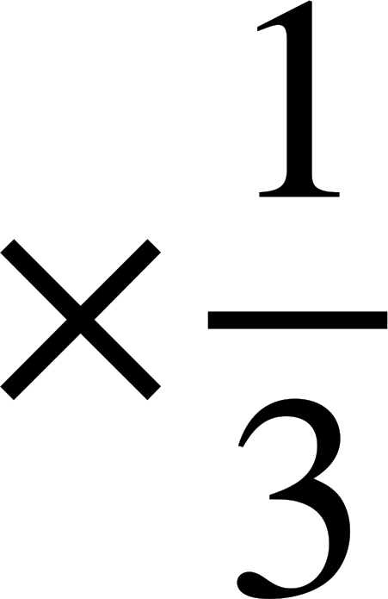
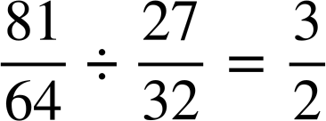
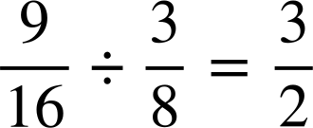

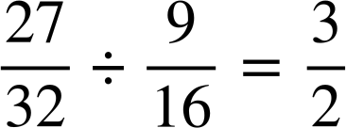
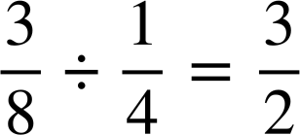
Finding the common ratio
1) Divide each term by the previous term to find the common ratio in each of these geometric sequences.
c) | 567, | 189, | 63, | 21, | 7, | …
7 ÷ 21 =
21 ÷ 63 =
63 ÷ 189 =
189 ÷ 567 =
d)

Slide 22


Finding the common ratio
2) a) This sequence is geometric. Show that it is and write a sentence to justify why it is.
768, 576, 432, 324, 243, …
243 ÷ 324 =
324 ÷ 432 =
432 ÷ 576 =
The sequence has a common ratio of between successive terms therefore is geometric.
576 ÷ 768 =

Slide 23
Finding the common ratio
2) a) This sequence is geometric. Show that it is and write a sentence to justify why it is.
768, 576, 432, 324, 243, …
768 | : | 576
4 | : | 3
576 | : | 432
4 | : | 3
432 | : | 324
4 | : | 3
324 | : | 243
4 | : | 3
768 | : | 576
576 | : | 432
432 | : | 324
324 | : | 243
÷192
÷192
You might also have said…
The sequence has a constant ratio of 4 : 3 between successive terms therefore is geometric.
Remember that the common ratio should be given as a single value though.
÷144
÷144
÷108
÷108
÷81
÷81

Slide 24



Finding the common ratio
2) b) This sequence is not geometric. Show that it is not and write a sentence to justify why it is not.
756, 252, 126, 42, 21, …
21 ÷ 42 =
42 ÷ 126 =
The sequence has a multiplicative relationship of between some terms and between others therefore is not geometric.
126 ÷ 252 =
252 ÷ 756 =

Slide 25
Finding the common ratio
2) b) This sequence is not geometric. Show that it is not and write a sentence to justify why it is not.
756, 252, 126, 42, 21, …
756 | : | 252
3 | : | 1
252 | : | 126
2 | : | 1
126 | : | 42
3 | : | 1
42 | : | 21
2 | : | 1
756 | : | 252
252 | : | 126
126 | : | 42
42 | : | 21
÷252
÷252
You might also have said…
÷126
÷126
The sequence has a ratio of 3 : 1 between some terms and 2 : 1 between others therefore is not geometric.
÷42
÷42
÷21
÷21

Slide 26
Recognising geometric sequences
Finding the common ratio
Using the common ratio

Slide 27



Using the common ratio
Sam and Jacob are looking at missing terms.
, | 3, | 15, | 75, | 375, | …
75 × 5 = 375
15 ÷ 5 = 3
÷5
÷5
×5
×5
3 ÷ 5 =
This is a geometric sequence with common ratio 5
Can you find the missing terms of this one?
Yes! I just multiply by 5 to find the 5th term, then I do the inverse of ÷5 to find the previous terms.

Slide 28
Using the common ratio
Sam and Jacob are looking at missing terms.
, | 3, | 15, | 75, | 375, | …
×5
×5
×5
×5
Yes! I just multiply by 5 to find the 5th term, then I do the inverse of ÷5 to find the previous terms.
I’ve checked it.
You’re right Jacob!

Slide 29

Using the common ratio
What is the 5th term of this geometric sequence?
, | 8, | 88, | 968, | 10 648, | …
×11
×11
968 ÷ 88 = 11
The common ratio between successive terms is 11
968 × 11 = 10 648

Slide 30
Using the common ratio
What is the 2nd term of this geometric sequence?
, | 8, | 88, | 968, | 10 648, | …
÷11
×11
×11
The inverse of ×11 is ÷11
88 ÷ 11 = 8

Slide 31
Using the common ratio
What is the 1st term of this geometric sequence?
, | 8, | 88, | 968, | 10 648, | …
To find a previous term we need to do the inverse of ×11
88
×11
×11
×11
×11
0.727
8 ÷ 11 = 0.727272… but when you round you lose accuracy.
8 ÷ 11 is most accurately and concisely communicated as a fraction.

Slide 32

Using the common ratio
It’s also possible to find missing terms in geometric sequences when you aren’t given successive terms.
1st | 2nd | 3rd | 4th | 5th
1 | 2 | 4 | 8 | 16
8 ÷ 2 = 4 so the common ratio must be 4
Jun is not right. How do you know?
3rd term : 2 × 4 = 8
4th term : 8 × 4 = 32

Slide 33
Using the common ratio
It’s also possible to find missing terms in geometric sequences when you aren’t given successive terms.
1st | 2nd | 3rd | 4th | 5th
1 | 2 | 4 | 8 | 16
2 × r × r = 8
×r
×r
I checked. The common ratio can’t be 4. It must something that multiplies by itself twice to make 4
2 × r² = 8
r² = 4

Slide 34
Using the common ratio
It’s also possible to find missing terms in geometric sequences when you aren’t given successive terms.
1st | 2nd | 3rd | 4th | 5th
1 | 2 | 4 | 8 | 16
2 × r × r = 8
×2
×2
×2
×2
2 × r² = 8
It’s 2
When you square 2 you get 4
r² = 4
r = 2

Slide 35
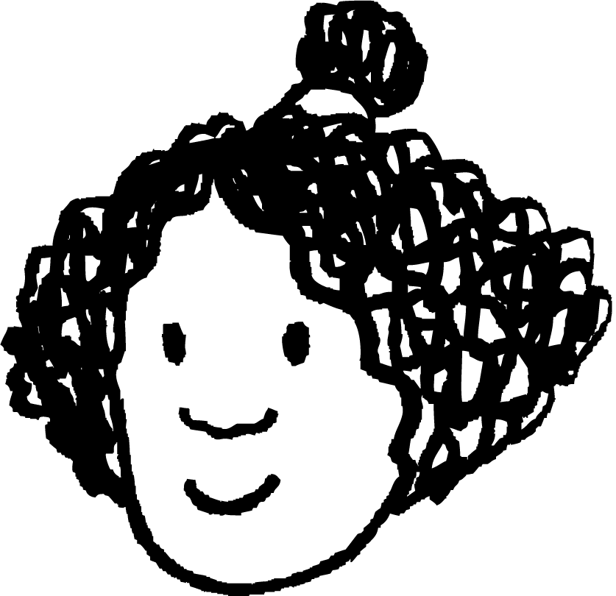
Using the common ratio
It’s also possible to find missing terms in geometric sequences when you aren’t given successive terms.
1st | 2nd | 3rd | 4th | 5th
1 | 2 | 4 | 8 | 16
1st | 2nd | 3rd | 4th | 5th
1 | 2 | 4 | 8 | 16
×2
×2
×2
×2
×r
×r
I’m so proud of myself!
Don’t celebrate too soon. There are actually two solutions to this problem.

Slide 36
Using the common ratio
It’s also possible to find missing terms in geometric sequences when you aren’t given successive terms.
r² = 4
1st | 2nd | 3rd | 4th | 5th
1 | 2 | 4 | 8 | 16
r = 2 or −2
Something else which squares to make 4?
×r
×r
Don’t celebrate too soon. There are actually two solutions to this problem.
Got it! Negative 2

Slide 37
Using the common ratio
It’s also possible to find missing terms in geometric sequences when you aren’t given successive terms.
r² = 4
1st | 2nd | 3rd | 4th | 5th
−1 | 2 | −4 | 8 | −16
r = 2 or −2
×−2
×−2
×−2
×−2
Well done Jun. You found both possible sequences.

Slide 38
Using the common ratio
What could the common ratio be for this geometric sequence?
1st | 2nd | 3rd | 4th | 5th
2 | 6 | 18 | 54 | 162
3
×3
×3
×3
×3
−3
1st | 2nd | 3rd | 4th | 5th
−2 | 6 | −18 | 54 | −162
9
×−3
×−3
×−3
×−3

Slide 39


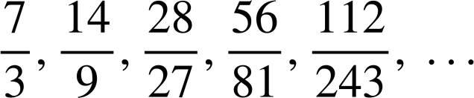
Using the common ratio
1) Find the missing terms in these geometric sequences.
a)
, | 17, | 51, | 153, | 459, | …
1125, | 225, | 45, | 9, | , | …
b)
c)
0.07, | 0.14, | 2.8, | 56, | 1120, | …
d)

Slide 40
Using the common ratio
2) Find the two possible geometric sequences given these missing, non-successive terms.
1st | 2nd | 3rd | 4th | 5th
4 | 20 | 100 | 500 | 2500

Slide 41


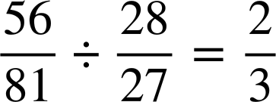

Using the common ratio
1) Find the missing terms in these geometric sequences.
a)
, | 17, | 51, | 153, | 459, | …
1125, | 225, | 45, | 9, | , | …
b)
×3
×3
×3
×3
153 ÷ 51 = 3
45 ÷ 225 =
c)
0.007, | 0.14, | 2.8, | 56, | 1120, | …
d)
×20
×20
×20
×20
2.8 ÷ 0.14 = 20

Slide 42
Using the common ratio
2) Find the two possible geometric sequences given these missing, non-successive terms.
1st | 2nd | 3rd | 4th | 5th
4 | 20 | 100 | 500 | 2500
4 × r × r = 100
4 × r² = 100
r² = 25
×5
×5
×5
×5
r = 5 or −5
1st | 2nd | 3rd | 4th | 5th
4 | −20 | 100 | −500 | 2500
×−5
×−5
×−5
×−5

Slide 43
Recognising geometric sequences
I can recognise geometric sequences by finding a common ratio between successive terms.
For example, 7, 14, 28, 56, … is geometric because it has a common ratio of 2 between successive terms.

Slide 44

© Oak National Academy 2024.
Produced in partnership with Mathematics in Education and Industry.
Licensed on the Open Government Licence v3.0, except where otherwise stated. See Oak terms and conditions.

